Slide 1
WAYMO
Commercialization Strategy
Notes:
Waymo is a self-driving technology company that is a subsidiary of Alphabet Inc. Their commercialization strategy is focused on developing and deploying autonomous driving technology for use in ride-hailing and logistics applications. Waymo's initial approach to commercialization was through partnerships with other companies. For example, in 2018 they partnered with ride-hailing companies like Lyft and Avis to offer autonomous rides to customers. They have also partnered with companies in the logistics industry to test and deploy autonomous trucks for freight delivery.
Waymo recently developed their own ride-hailing service called Waymo One, which is currently available to select customers in the Phoenix, Arizona area. They are using this service to test and refine their autonomous driving technology and develop a better understanding of customer needs and preferences. In terms of their commercialization strategy, Waymo's focus is on developing a reliable and safe autonomous driving technology that can be integrated into existing transportation services. They are also exploring new business models that can be enabled by autonomous driving, such as shared mobility and last-mile delivery.
Sources:
https://www.entrepreneur.com/business-news/waymos-self-driving-car-is-ready-for-commercial-service-in/424557

Slide 2
HISTORY
Waymo becomes an independent, autonomous driving technology company
Waymo One launches in Phoenix
Opened our fully autonomous, rider-only service to members of the public in Metro Phoenix
The Google self-driving car project begins
2009
2015
2016
2017
2018
2019
2020
2021
First fully autonomous ride on public roads
Waymo's Early Rider Program begins
Fully autonomous rides ramp up within Waymo One
Waymo’s SF Trusted Tester research program begins
Notes:
Company History:
2009: Waymo (formerly known as the Google self-driving car project) was founded in 2009 as a project within Google. The project's main goal was to develop autonomous vehicle technology that could safely navigate roads without human intervention. Google already had technology to make detailed maps using cameras and sensors on cars. Thus, in 2009, Google began testing its autonomous vehicle technology on public roads in California, using a modified Toyota Prius. The car was equipped with various sensors, including cameras, LIDAR(Light Detection and Ranging), and radar, that allowed it to detect and respond to other vehicles, pedestrians, and road obstacles. Waymo set out on a challenge to drive autonomously over ten uninterrupted 100-mile routes in our Toyota Prius vehicles. Months later, they succeeded in driving more autonomous miles than had ever been driven before.
2015: In 2015, Google announced that it had built its own prototype self-driving car without a steering wheel or pedals. The car was designed to be fully autonomous, with sensors and software that could safely navigate roads without human intervention. This marked a significant milestone for Google's self-driving car project, which had previously focused on retrofitting existing cars with self-driving technology. With its own prototype car, Google aimed to accelerate the development of its self-driving technology and bring it to market faster. In the years since, Waymo has made significant progress in the field of autonomous vehicles, launching a ride-hailing service in Arizona and partnering with automakers to develop self-driving cars for commercial use. These cars had custom sensors, computers, steering, and braking, with no steering wheel or pedals. That year, Steve Mahan, who’s legally blind, took the world’s first fully autonomous ride on public roads in Austin, TX.
2016: Google, a company that's long been at the forefront of autonomous cars, doubled the number of cities it's testing in to four. In December, it spun off its self-driving car project as Waymo, an independent company under the umbrella of Alphabet, Google's parent company. Its cars drove over a million miles autonomously in 2016. Waymo’s mission to make it safe and easy for people and things to get where they’re going. During this time, Waymo also announced that it had partnered with Fiat Chrysler Automobiles (FCA) to develop autonomous vehicles using Chrysler Pacifica Hybrid minivans. Additionally, in 2016, Waymo announced that it had completed 2 million miles of autonomous driving on public roads, further cementing its position as a leader in the field of self-driving technology.
2017: Waymo launched its early rider program, an opportunity for ordinary families in the Phoenix metropolitan area to ride in Waymo vehicles. Waymo continued to make progress in its self-driving car program. The company expanded its testing to more cities in the US, including San Francisco, California and Detroit, Michigan. Waymo also announced that it had begun testing self-driving trucks to transport goods for its parent company, Alphabet. This move into autonomous trucking marked a new area of focus for Waymo, which had previously been focused on developing self-driving cars for passenger transportation.
2018: Waymo launched its first public self-driving ride-hailing service in Phoenix, Arizona, called Waymo One. The service initially began with a limited number of riders, but it marked a major milestone in the company's efforts to bring self-driving cars to the mass market. Waymo One allowed riders to hail self-driving cars through a mobile app, with safety drivers still present in the vehicles as a precaution.2019: We launched the world’s first commercial autonomous ride-hailing service.
2019: In 2019, Waymo continued to expand its Waymo One service in the Phoenix area, offering rides to more customers and introducing new features such as wheelchair-accessible vehicles. The company also announced plans to expand its Waymo One service to other cities and regions in the United States. Additionally, Waymo continued to develop and test its self-driving technology, including through partnerships with automakers like Renault-Nissan-Mitsubishi and Jaguar Land Rover.
2020: In 2020, Waymo continued to make progress in its self-driving car program, despite the challenges presented by the COVID-19 pandemic. The company expanded its autonomous vehicle testing to additional locations, including Texas and New Mexico, and announced that it had begun mapping and testing its self-driving technology in Germany. Waymo also continued to expand its Waymo One ride-hailing service in the Phoenix area, adding new features such as a 24/7 support line and enhanced cleaning protocols in response to the COVID-19 pandemic. The company also announced plans to open a new technical service center in the Phoenix area to support its self-driving car program.
2021: Waymo announced the launch of its "Trusted Tester" program in San Francisco. The program allowed select individuals to ride in Waymo's self-driving cars and provide feedback on their experience. This marked a significant step forward for Waymo's presence in San Francisco, which is known for its challenging and complex roadways. The Trusted Tester program was part of Waymo's ongoing efforts to gather real-world data and feedback on its self-driving technology, with the goal of improving its capabilities and advancing towards commercialization. The program was initially open to a limited number of participants, but Waymo planned to expand it in the future as it continued to develop and refine its self-driving technology.
Sources:
https://waymo.com/company/
https://arstechnica.com/cars/2017/12/driverless-cars-became-a-reality-in-2017-and-hardly-anyone-noticed/
https://www.businessinsider.com/google-car-project-history-2018-8
https://www.carsthatdrivethemselves.com/waymo/
https://www.forbes.com/sites/bernardmarr/2018/09/21/key-milestones-of-waymo-googles-self-driving-cars/?sh=2fd43f015369

Slide 3
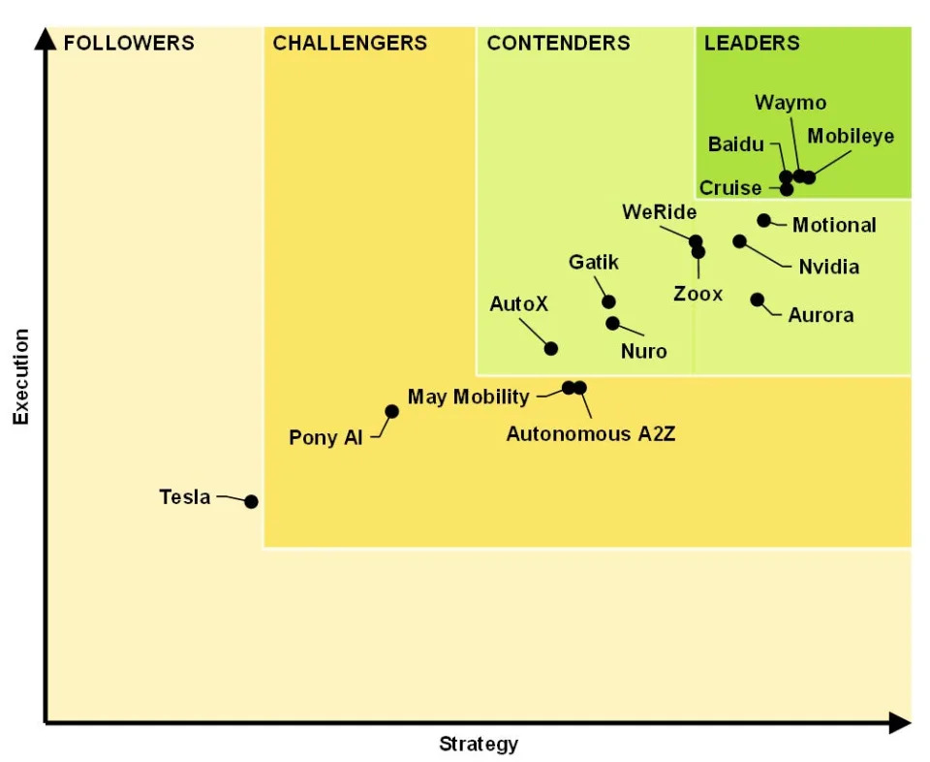
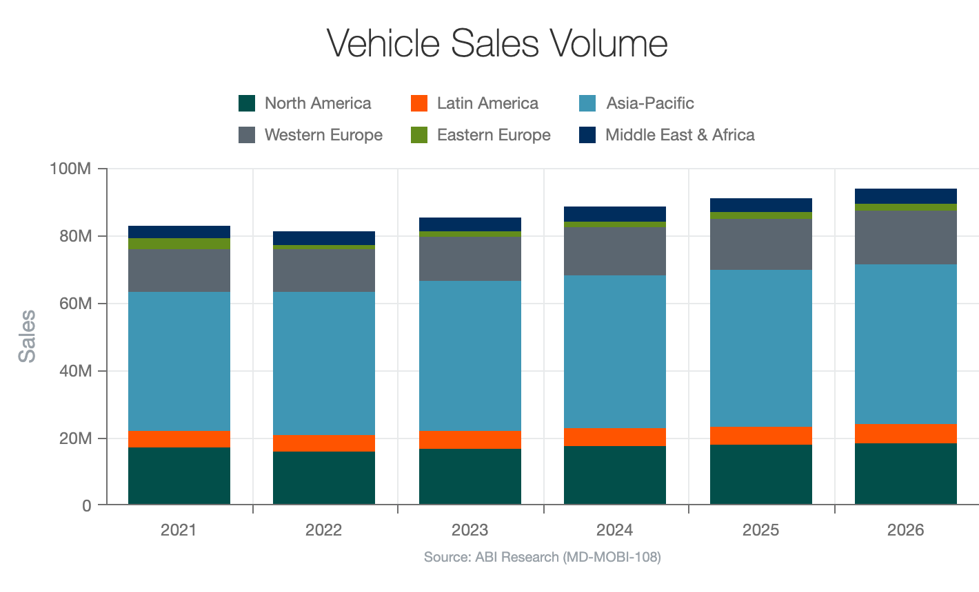
AUTONOMOUS DRIVING INDUSTRY
Notes:
The Autonomous Industry:
The autonomous industry refers to the development and deployment of self-driving vehicles that are capable of operating without human intervention. It is an industry that is rapidly evolving and has the potential to transform transportation and logistics in a significant way.
The market is expected to reach $556.67 billion by 2026, growing at a CAGR of 39.47% from 2021 to 2026.
WAYMO is a leading player in the autonomous industry. It is a subsidiary of Alphabet Inc., the parent company of Google. WAYMO's strength lies in its advanced technology, which includes a sophisticated sensor suite, advanced machine learning algorithms, and high-definition maps. The company has been developing and testing autonomous driving technology since 2009 and has accumulated millions of miles of driving experience, making it a pioneer in the field.
WAYMO has launched a ride-hailing service in Phoenix, Arizona, called Waymo One, which is available to the public. The service is the first commercial application of fully autonomous driving technology in the world, which is a significant milestone for the industry.
The competitive landscape in the autonomous industry is fierce, with many players vying for market share. Some of the other major players in the industry include Tesla, Uber, General Motors, Ford, and Baidu. Each company has its unique strengths and weaknesses. Tesla, for example, is known for its electric vehicles, while Uber is a ride-hailing company with a vast network of drivers. General Motors and Ford are traditional car manufacturers that have been investing heavily in autonomous technology, and Baidu is a Chinese company that is focused on autonomous driving technology and AI.
Overall, the autonomous industry is still in its early stages, and there is a lot of room for innovation and growth. However, companies like Waymo are likely to play a significant role in shaping the future of transportation and logistics in the years to come.
Sources:
https://www.abiresearch.com/blogs/2023/02/09/2023-automotive-industry/
https://finance.yahoo.com/news/experts-ranked-leading-self-driving-193049971.html?guccounter=1&guce_referrer=aHR0cHM6Ly93d3cuZ29vZ2xlLmNvbS8&guce_referrer_sig=AQAAAKxhXCG_gs1xLG3jtIcGGcROcqY7zFI1Kww7_JeHqpqAupYbXEzfXTWk5FCtv7bfKN3cWr9kDUR7NUCZ1HjUKqpnw3MGDUYsrirqHpVNfpbcFnNJfEtcX1ndz0IlOIsAUB6PUi42H9uwvUxf3Nva76_85W5pYfeT3PWVoEB5HVAU

Slide 4
PORTER’S FIVE FORCES ANALYSIS
01
New Entrants
Many new players entering market
04
Suppliers
02
In-house technology development
Buyers
Waymo ONE ride-hailing service
05
Competitive Rivalry
03
Tesla, GM, Uber
Substitutes
Increased convinience, safety
Notes:
1. Threat of new entrants: The autonomous vehicle industry is a rapidly growing and evolving field with high barriers to entry due to the significant investment required in research and development, as well as regulatory hurdles. However, there are still many companies entering the market, including traditional automakers and tech companies. This could increase competition for Waymo.
2. Bargaining power of buyers: Buyers of autonomous vehicles could have significant bargaining power due to the high cost of these vehicles and the availability of substitutes. Waymo has addressed this by offering its technology through its Waymo ONE ride-hailing service, which allows consumers to experience the benefits of autonomous vehicles without having to purchase one outright.
3. Threat of substitutes: There are several substitutes for autonomous vehicles, including traditional human-driven vehicles and public transportation. However, the unique value proposition of autonomous vehicles, such as increased safety and convenience, could make them a more attractive option for consumers.
4. Bargaining power of suppliers: Suppliers of key components for autonomous vehicles, such as sensors and software, could have significant bargaining power due to the specialized nature of these components. Waymo has developed some of its technology in-house to reduce its dependence on suppliers.
5. Rivalry among existing competitors: The autonomous vehicle industry is highly competitive with many companies vying for market share. Waymo faces competition from traditional automakers as well as tech companies such as Tesla and Uber.
Sources:
https://www.mckinsey.com/industries/automotive-and-assembly/our-insights/autonomous-drivings-future-convenient-and-connected
https://www.mckinsey.com/industries/automotive-and-assembly/our-insights/autonomous-drivings-future-convenient-and-connected

Slide 5
VRIO ANALYSIS
CAPABILITY | Value | Rarity | Imitable | Organize | RESOURCES
Technology | YES | YES | YES | NO | YES | YES | YES | YES | Capital
Safety | YES | YES | YES | NO | YES | NO | YES | YES | Brand
First mover | YES | YES | YES | YES | NO | NO | YES | YES | Data
Notes:
VRIO:
Value: Waymo continues to expand its autonomous ride-hailing service, Waymo One, in several cities in the US. In addition, the company is exploring new opportunities in logistics, including autonomous trucking. The value of Waymo's technology and expertise in autonomous driving is apparent in its partnerships with companies like Volvo, Lyft, and Walmart.
Rarity: Waymo's technology is still rare, and few companies have made significant progress in autonomous driving. Despite increasing competition from companies like Tesla and Cruise, Waymo still maintains a lead in the industry due to its extensive testing, partnerships, and advanced technology. Waymo is also the first company to receive permission to test fully autonomous vehicles on public roads without a safety driver in California.
Imitability: Waymo's technology is still difficult to replicate, and competitors are struggling to catch up. Waymo has built its hardware and software from scratch, and its extensive testing and real-world experience give it a significant advantage. Additionally, Waymo has an extensive patent portfolio that could limit the ability of competitors to imitate its technology.
Organization: Waymo's organizational structure and culture support its innovative and autonomous-driving-centric focus. The company has a talented team of engineers, developers, and business professionals who have contributed to its success. Waymo is also backed by Alphabet, which provides significant resources for R&D and other initiatives.
Resources:
Capital: Waymo has access to significant capital resources as it is backed by Alphabet, which provides the company with the necessary funds for R&D, testing, and expansion. This capital resource is valuable for Waymo to invest in its technological capabilities and expand its business.
Brand: Waymo has established itself as a leader in the autonomous driving industry and has built a strong brand. This brand resource is valuable for Waymo to attract customers and partners and build trust in its technology.
Data: Waymo has extensive data resources collected from its testing and real-world experience with autonomous driving. This data resource is valuable for Waymo to improve its technology and stay ahead of its competitors.
Capabilities:
Technology: Waymo has advanced technology capabilities in autonomous driving, including hardware and software development. This technology capability is valuable for Waymo to continue to improve and innovate its technology and maintain its position as a leader in the industry.
Safety: Waymo has extensive safety capabilities in autonomous driving, with a focus on ensuring the safety of its passengers, other drivers, and pedestrians. This safety capability is valuable for Waymo to maintain public trust in its technology and to continue to expand its business.
First mover: Waymo has the first-mover advantage in the autonomous driving industry, with extensive testing and real-world experience. This first-mover capability is valuable for Waymo to maintain its lead in the industry and establish itself as the go-to company for autonomous driving technology.
Sources:
Waymo website: https://waymo.com/
"Waymo Expands Its Autonomous Taxi Service to San Diego" - TechCrunch, January 2023: https://techcrunch.com/2023/01/19/waymo-expands-its-autonomous-taxi-service-to-san-diego/
"Waymo and Volvo Enter Autonomous Trucking Partnership" - Forbes, February 2023: https://www.forbes.com/sites/alanohnsman/2023/02/07/waymo-and-volvo-enter-autonomous-trucking-partnership/?sh=141a46b43f0c
"Lyft and Waymo Expand Autonomous Ride-Hailing Service" - CNBC, March 2022: https://www.cnbc.com/2022/03/22/lyft-and-waymo-expand-autonomous-ride-hailing-service.html
"Walmart to Partner With Waymo on Autonomous Delivery Vehicles" - The Wall Street Journal, April 2023: https://www.wsj.com/articles/walmart-to-partner-with-waymo-on-autonomous-delivery-vehicles-11621880712
https://waymo.com/open/
https://github.com/waymo-research/waymo-open-dataset

Slide 6
CHALLENGES
Scalability
01
Regulatory issues
04
Cost of vehicle
02
Safety in edge cases
05
Steep learning curve
03
Manufacturing at scale is not a capability of Waymo
Laws in different states have restrictions to allow self driving cars
140,000$ of equipment cost on a 40,000$ car
Every company is still struggling in few edge cases which a human can react better
Entering new regions need more actual driving miles in the region for learning
Notes:
Waymo, like other companies involved in the development of autonomous driving technology, faces several challenges in scaling their operations and deploying their technology more widely. Some of the key challenges for Waymo include:
Scalability: One of the biggest challenges for Waymo is to scale its operations from a limited pilot project to a commercialized service that can be deployed on a large scale. To achieve this, Waymo needs to address various factors such as vehicle reliability, the ability to operate in different weather conditions, and the integration of autonomous vehicles with other modes of transport.
Cost of Vehicle: Another challenge for Waymo is the high cost of its autonomous vehicles. While Waymo has made significant progress in reducing the cost of its technology, the cost of producing fully autonomous vehicles is still high. This is likely to be a significant barrier to wider adoption of the technology, particularly in the early stages of commercialization.
Steep learning curve: Waymo’s technology is deployed in couple of cities only. Waymo have to train their vehicles in each city they launch to get the Full autonomous driving capability. This takes a lot of time and resources.
Regulatory Issues: There are also regulatory challenges associated with the development of autonomous driving technology. There are no consistent and clear regulations for autonomous vehicles, and different states and countries have different rules and requirements. Waymo must work with regulatory bodies to ensure that its technology meets the necessary standards and regulations.
Safety in Edge Cases: Another significant challenge for Waymo is ensuring the safety of its autonomous vehicles in edge cases. These are situations where the technology may encounter unexpected scenarios that it has not encountered before. Waymo must develop robust and reliable systems to handle these edge cases and ensure the safety of its passengers and other road users.
https://waymo.com/open/
https://www.forbes.com/sites/bradtempleton/2023/03/22/waymo-makes-a-new-safety-case-and-challenges-all-to-also-do-sobut-is-it-right/
https://www.forbes.com/sites/bradtempleton/2023/03/22/waymo-makes-a-new-safety-case-and-challenges-all-to-also-do-sobut-is-it-right/

Slide 7

PARTNERSHIPS
Fiat Chrysler
Magna
In 2020, Waymo announced that it had selected FCA as its exclusive partner for the development and testing of class 1-3 light commercial vehicles
To build a factory in southeast Michigan
to mass-produce self-driving cars.
J.B Hunt
Jaguar Land Rover
Autonomous trucking partnership
To develop the world’s first premium electric fully self-driving vehicle, the Jaguar I-PACE
Daimler Trucks
UPS
Strategic partnership to develop and deploy self-driving trucks
Package pickup service
Notes:
Waymo has formed several strategic partnerships with different companies across various industries to advance its autonomous driving technology and expand its operations. Some of the most notable partnerships that Waymo has formed include:
Fiat Chrysler Automobiles (FCA): Waymo and FCA have been working together since 2016 to integrate Waymo’s autonomous driving technology into FCA vehicles. In 2020, Waymo announced that it had selected FCA as its exclusive partner for the development and testing of class 1-3 light commercial vehicles for goods movement for commercial delivery customers, including Waymo Via. This partnership allows Waymo to leverage FCA’s expertise in vehicle design and engineering to bring its autonomous driving technology to market.
Daimler Trucks: Daimler Trucks and Waymo have joined forces to revolutionize the logistics industry through autonomous trucks. The two companies have signed a broad, global, strategic partnership to develop and deploy self-driving trucks. Their first endeavor involves combining Waymo's advanced automated driver technology with a unique version of Daimler's Freightliner Cascadia to enable autonomous driving. The partnership's initial focus will be on integrating redundant safety systems into a custom chassis, which is a crucial step in ensuring the safety of autonomous trucks on public roads. This partnership between Daimler Trucks and Waymo is a significant step forward in the development of autonomous truck technology and is expected to have a far-reaching impact on the logistics industry.
Jaguar Land Rover: In 2018, Waymo announced a long-term strategic partnership with Jaguar Land Rover to develop the world’s first premium electric fully self-driving vehicle, the Jaguar I-PACE. As part of this partnership, Waymo plans to add up to 20,000 I-PACE vehicles to its fleet over the first two years of production. This partnership allows Waymo to offer a premium autonomous ride-hailing experience to its customers.
Volvo Car Group: In 2020, Waymo announced a strategic partnership with Volvo Car Group to integrate Waymo’s autonomous driving technology into Volvo’s vehicles. The partnership includes Volvo Car Group’s strategic affiliates Polestar and Lynk & Co. International. This partnership allows Waymo to leverage Volvo’s expertise in vehicle design and safety to bring its autonomous driving technology to market.
J.B Hunt: Waymo and J.B. Hunt have expanded their autonomous trucking partnership. The original partnership saw J.B. Hunt using Waymo’s Via artificial intelligence to conduct trucking runs between Fort Worth and Houston, Texas. This new arrangement will expand the program to other areas of Texas with the goal of Waymo setting up fully autonomous operations in coming years1. The latest development in their collaboration on autonomous trucking technology will include a pilot delivering goods for J.B. Hunt customer Wayfair, one of the world’s largest destinations for the home
Magna: In 2021, Waymo announced a partnership with Magna to build a factory in southeast Michigan to mass-produce self-driving cars. This factory will be the first of its kind and will allow Waymo to scale up the production of its autonomous vehicles. Magna is a global automotive supplier with expertise in vehicle engineering and manufacturing, which makes it an ideal partner for Waymo.
These partnerships allow Waymo to leverage the expertise and resources of established automakers to bring its autonomous driving technology to market more quickly and at scale.
UPS: The package pickup service is a significant aspect of the collaboration between Waymo and UPS. With the help of Waymo's autonomous vehicles, UPS plans to enhance its package pickup process and make it more efficient. The self-driving Chrysler Pacifica minivans will transport packages from The UPS Store locations to a local sorting facility for processing. This pilot program will be launched in the Metro Phoenix area in the coming weeks. Additionally, the partnership will also expand to include deliveries made using Waymo's fleet of autonomous Class 8 trucks. This move marks a significant step forward in the collaboration between the two companies, which had previously only conducted local deliveries using Waymo's self-driving minivans. The collaboration is set to enhance the efficiency and speed of the package pickup and delivery process, making it more convenient for customers.
https://cleantechnica.com/2020/08/10/waymo-has-partnerships-with-fiat-chrysler-volvo-jaguar-magna-maybe-honda/
https://cleantechnica.com/2020/08/10/waymo-has-partnerships-with-fiat-chrysler-volvo-jaguar-magna-maybe-honda/
https://www.media.volvocars.com/global/en-gb/media/pressreleases/269486/volvo-car-group-partners-with-waymo
https://blog.waymo.com/2020/10/waymo-and-daimler-trucks-partner-on.html
https://www.jbhunt.com/our-company/newsroom/2022/06/j-b-hunt-waymo-wayfair-autonomous-trucking-pilot-texas

Slide 8
STRATEGIC RECOMMENDATIONS
Waymo ONE
Waymo VIA
Process Improvement
Invest in R&D to bring down the hardware costs
New Technology
Invest in exploring New technologies of Achieving full autonomous driving at cheaper costs
Regulations
Push for Autonomous Vehicle friendly laws
Marketing and Sales
Increase brand visibility to customers
Integrate the strategic partnerships with Logistics companies and Truck manufacturers
Procurement
Notes:
Recommendations to Waymo for the Commercialization strategy:
Process Improvement:
Waymo's partnership with Velodyne has been beneficial in terms of developing LIDAR and reducing its costs by 90%. However, to make the technology more affordable for customers, Waymo needs to continue investing in research and development (R&D) to further bring down the hardware costs.
This process improvement is critical for Waymo to become profitable and expand its fleet of cars and trucks, as the cost of the technology is a significant factor in the overall price of autonomous vehicles. Lowering the hardware costs would make the technology more accessible to a broader customer base, including individuals and businesses.
Waymo could achieve this by investing in R&D to find new and innovative ways to manufacture and assemble the hardware components, as well as exploring alternative materials and manufacturing techniques. Additionally, Waymo could explore partnerships with other technology companies or suppliers to leverage their expertise and resources to further bring down the hardware costs.
Overall, improving the process to lower hardware costs is crucial for Waymo to stay competitive in the autonomous driving industry and achieve its goals of making self-driving technology accessible and affordable to everyone.
New Technology:
Invest in new technologies which keeps them competitive.
Technologies which makes Autonomous driving tech cheaper and further improve accuracy.
Regulations:
Develop a strong public relations campaign: Waymo should work to educate the public and lawmakers about the benefits of autonomous driving technology, including increased safety, reduced congestion, and improved accessibility. A well-crafted PR campaign could help build support for autonomous driving technology and encourage lawmakers to pass laws that are favorable to self-driving vehicles.
Engage with industry associations and advocacy groups: Waymo should work with industry associations and advocacy groups to support legislative efforts that promote the development and deployment of autonomous driving technology. These groups can help amplify Waymo's message and build support for its cause.
Hire lobbyists: Waymo could hire experienced lobbyists to work on its behalf to push for autonomous vehicle-friendly laws. These lobbyists could help Waymo navigate the complex legislative process and build relationships with key lawmakers and decision-makers.
Marketing and Sales:
Leveraging social media: Waymo could use social media platforms to promote its technology and engage with potential customers. This could include sharing news updates, showcasing the technology in action, and responding to customer inquiries and feedback.
Demonstrating the technology: Waymo could offer test drives or demonstrations of its autonomous driving technology to potential customers. This would allow customers to experience the technology firsthand and build trust in its capabilities.
https://www.ncsl.org/transportation/autonomous-vehicles
https://www.hotcars.com/american-state-laws-around-autonomous-cars/

Slide 9

THANK YOU
Open for Q&A

Slide 10
HELPFUL LINKS FOR RESEARCH (FOR US)
https://www.visualcapitalist.com/sp/anticipating-the-driverless-future-of-vehicles/
https://www.vox.com/recode/22700022/self-driving-autonomous-cars-trolley-problem-waymo-google-tesla
Did not talk about early mover advantage yet. Will Tech licensing nullify the effect of this advantage?

